Slide 1
Wireless: Network Forensics Unplugged
Chapter 6

Slide 2
Introduction
Types of wireless devices and networks:
AM/FM radios
Cordless phones
Cell phones
Bluetooth headsets
Infrared devices, such as TV remotes
Wireless doorbells
Zigbee devices, such as HVAC, thermostat, lighting, and electrical controls
Wi-Fi (802.11) – LAN networking over RF
WiMAX (802.16) – “last-mile” broadband

Slide 3
Overview
The IEEE Layer 2 protocol series
Wireless Access Points (WAPs)
Wireless traffic capture and analysis
Common attacks
Locating wireless devices

Slide 4
The IEEE Layer 2 protocol series
Why so many layer 2 protocols?
CSMA/CD
CSMA/CA
The 802.11 protocol suite
Three types of 802.11 frame
Management frames (figure 6-1)
Control frames
Data frames
Notes:
Management frames – govern communications between stations, except flow control.
Control frames – support flow control over a variably available medium (such as RF)
Data frames – Encapsulates the layer 3+ data that moves between stations actively engaged in communication on a wireless network.

Slide 5
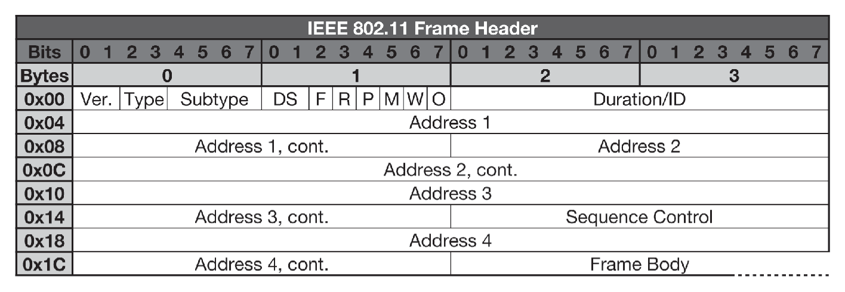
From Network Forensics, by Sherri Davidoff and Jonathan Ham (ISBN: 978-0-13-256471-7) Copyright © 2012 Pearson Education, Inc. All rights reserved.
Figure 6.1 The 802.11 frame’s data structure, which includes four fields for 6-byte MAC addresses per frame. How each is used is dependent upon the frame’s type and subtype.

Slide 6
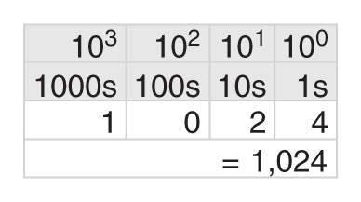
From Network Forensics, by Sherri Davidoff and Jonathan Ham (ISBN: 978-0-13-256471-7) Copyright © 2012 Pearson Education, Inc. All rights reserved.
Figure 6.2 Base10: From left to right, 1000s, 100s, 10s, 1s. Since we normally read Hindu-Arabic numerals from left to right, beginning with the “most significant bit,” this numbering system is “big-endian.”

Slide 7
The IEEE Layer 2 protocol series (con’t)
802.11 Frame Analysis
Endianness (based on Gulliver’s Travels and the Lilliputians and Blefuscuians)
Big-endian = when the most significant digit is ordered first, it is known as big-endian.
Little-endian = when the least significant digit is ordered first, it is know as little-endian.
Network-byte order (TCP/IP, but NOT 802.11)
802.11 Endianness
Mixed-Endian? See figures 6-3 and 6-4
Notes:
Network Protocols: Big-Endian or Little-Endian?
With respect to network protocols, if the most significant value is transmitted first, the system is “big-endian.” if the least significant value is transmitted first, the system is “little-endian.” if the system is a combination of these methods, it is considered “mixed-endian” or “middle-endian.” (p207)
RFC 791 describes the order of transmission for the “Internet Protocol – Appendix B: Data Transmission Order”.
Mixed-endian = bit ordering in each individual data field is big-endian, the fields themselves are transmitted in reverse order, within the byte-boundaries.

Slide 8
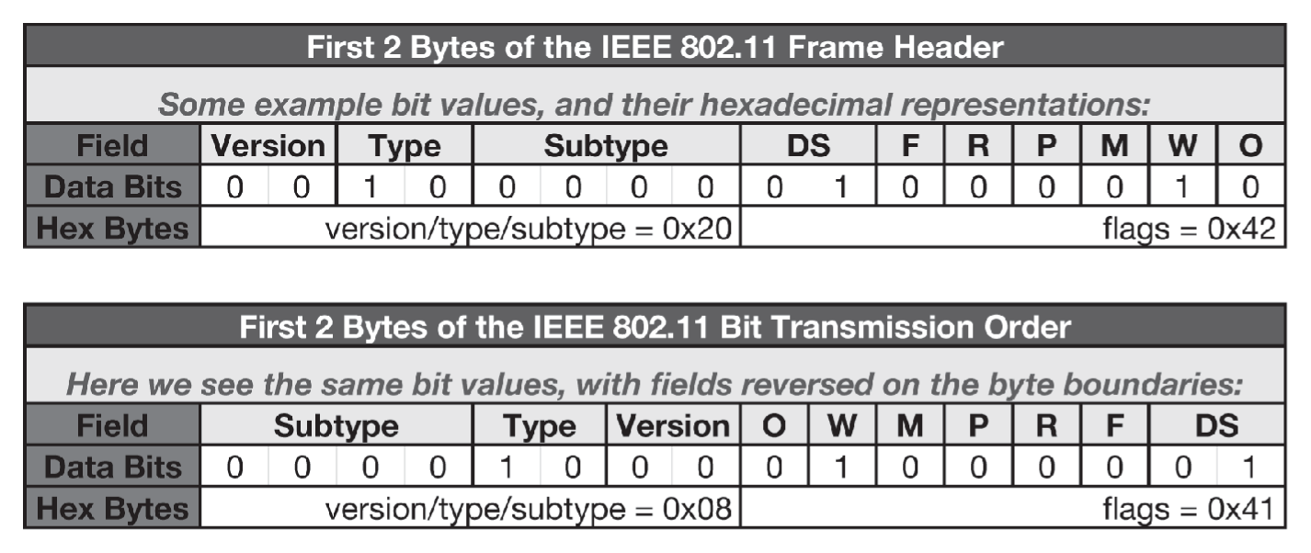
From Network Forensics, by Sherri Davidoff and Jonathan Ham (ISBN: 978-0-13-256471-7) Copyright © 2012 Pearson Education, Inc. All rights reserved.
Figure 6.3 802.11 traffic: Comparison of field orders within the byte-boundaries. The top diagram represents the protocol specification, whereas the bottom diagram represents the order of bits captured via libpcap.

Slide 9
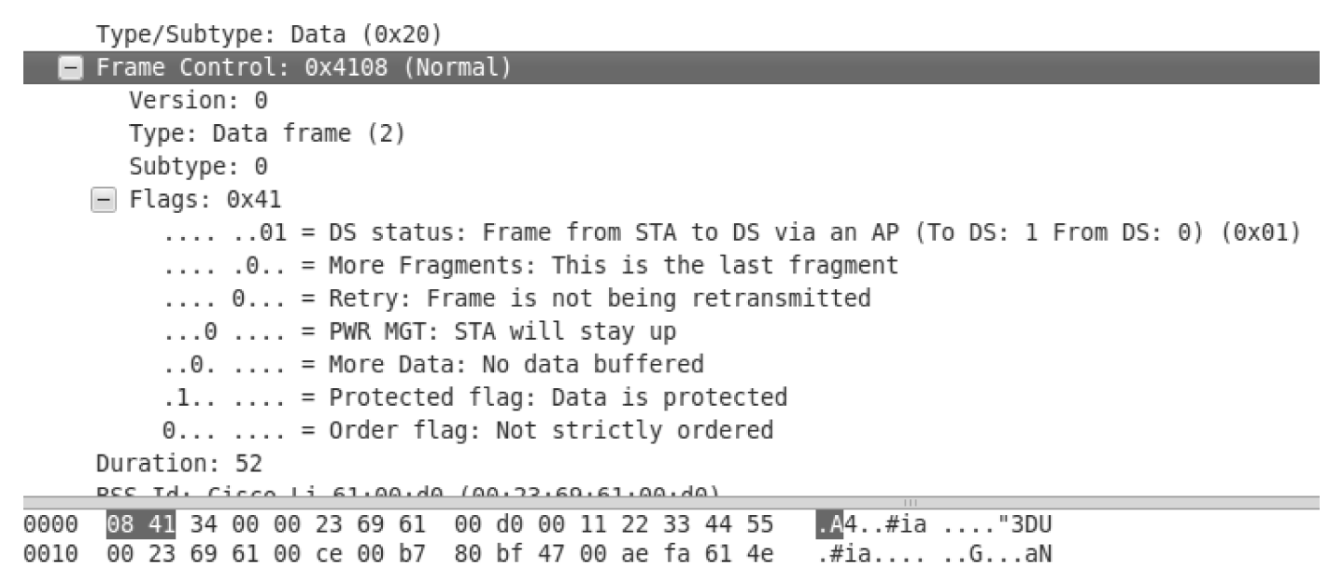
From Network Forensics, by Sherri Davidoff and Jonathan Ham (ISBN: 978-0-13-256471-7) Copyright © 2012 Pearson Education, Inc. All rights reserved.
Figure 6.4 In the Packet Details panel, Wireshark interprets the 802.11 frame correctly. In the Packet Bytes panel below, you can see the order that the bits were actually transmitted across the wire (shown as hexadecimal). The 802.11 transmission was mixed-endian.

Slide 10
The IEEE Layer 2 protocol series (con’t)
Wired Equivalent Privacy (WEP)
Problems in WEP-land
If WEP is so broken, why still study it?
How can you tell if a packet capture or stream is encrypted?
Privacy sub-field: marked as “W” in figure 6-3, this is known as the “protected” bit.
TKIP, AES, WPA, and WPA2
Temporal Key Integrity Protocol (TKIP)
Advanced Encryption Standard (AES)
Wi-Fi Protected Access (WPA, and version 2)
Notes:
WPA is:
Designed to work with legacy 802.11 hardware.
Intended to compensate for keying weaknesses (using TKIP)
Already broken
WPA2 is:
Next generation hardware required
Built to utilize AES-CCMP (real crypto!)
Currently considered secure when used with strong pre-shared keys or in combination with strong 802.1X authentication mechanisms.

Slide 11
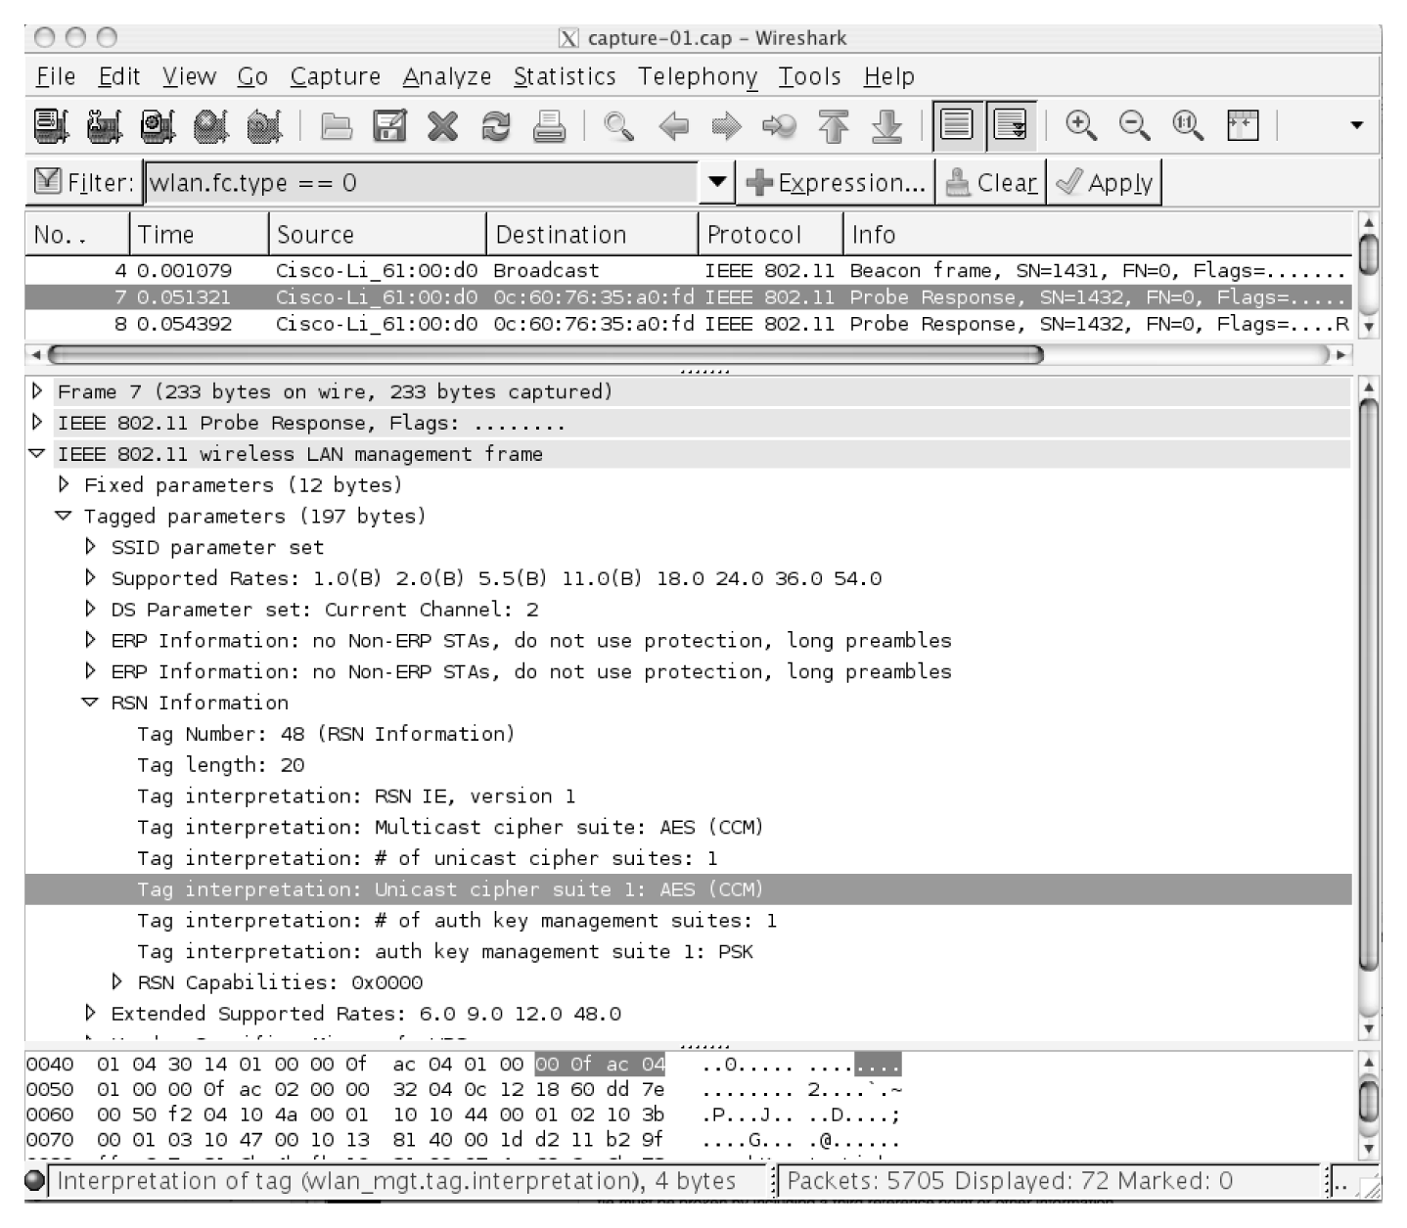
From Network Forensics, by Sherri Davidoff and Jonathan Ham (ISBN: 978-0-13-256471-7) Copyright © 2012 Pearson Education, Inc. All rights reserved.
Figure 6.5 An 802.11 packet capture displayed in Wireshark. Having filtered down to only management frames, a probe response is selected. The Packet Details panel shows the RSN Information within the tagged parameters, indicating that AES-CCMP is used as the cipher. Note that this is a clear indication that WPA2 is used, and not WPA, since WPA doesn’t support AES-CCMP.

Slide 12
The IEEE Layer 2 protocol series (con’t)
802.1X (designed to provide a modular, extensible authentication framework for LANs. Requires a backend authentication system that typically stores access logs)
Impact on wireless networks (community move to PEAP authentication over LEAP, due to cracking ease of LEAP passwords with “asleap”)
Implications for the investigator
Backend system (whether RADIUS or AD) is much more likely to have an audit trail
LEAP in use: consider network compromise due to use of weak authentication mechanism a very real possibility

Slide 13
Wireless Access Points (WAPs)
Why investigate WAPs?
May contain locally stored logs of connection attempts, authentication successes/failures, and other WAP activity
Logs can help track physical movements of a wireless client throughout a building or campus
Configuration may provide insight regarding how an attacker gained access to the network
Configuration may have been modified by an unauthorized party as part of an attack
WAP itself may be compromised

Slide 14
Wireless Access Points (WAPs) (con’t)
Types of WAPs:
Enterprise
Span larger geographic ranges than home offices or small businesses, typically setup to provide seamless, ubiquitous coverage throughout the environment.
Consumer
Apple Airport Express (figure 6-6, next slide)
Linksys WRT54G
Notes:
Enterprise features:
Support for IEEE 802.11a/b/g/n
Physical media is RF waves
Layer 3+ functionality, including:
Support for routing protocols
DHCP
Network address translation
Packet filtering
Centralized authentication
Auditable access logs (local and central)
Station location tracking
Performance monitoring capabilities
Power over Ethernet (PoE)
Indoor and outdoor options
The interface options for enterprise-class wireless access points frequently include:
Console (command-line interface (CLI))
Remote console (SSH/Telnet)
SNMP
Web interface
Proprietary interface
Central management interface
Consumer features include:
Support for IEEE 802.11a/b/g/n
Physical media is RF waves
Often contain Layer 3+ functionality, inlcuding:
Limited routing
DHCP service
NATing
Limited filtering
Logging (locally and sometimes remotely)

Slide 15
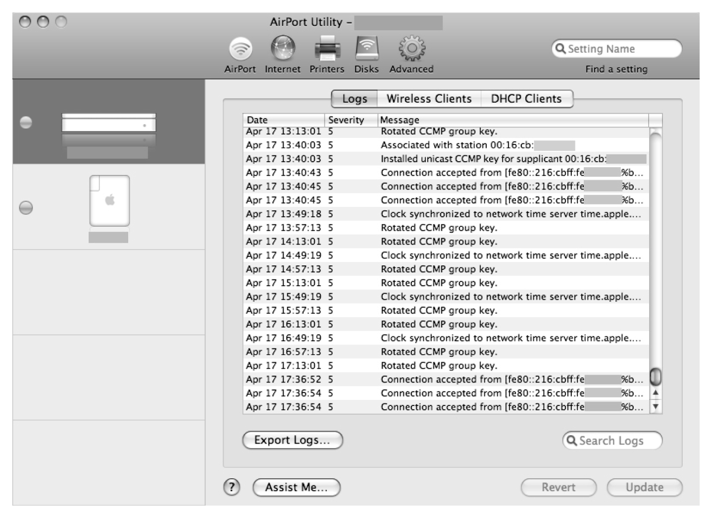
From Network Forensics, by Sherri Davidoff and Jonathan Ham (ISBN: 978-0-13-256471-7) Copyright © 2012 Pearson Education, Inc. All rights reserved.
Figure 6.6 Log entries saved locally on an Apple Airport, accessed through the native, proprietary
Airport Utility. These logs can also be exported via Syslog or SNMP.

Slide 16
Wireless Access Points (WAPs) (con’t)
WAP evidence
Volatile
Much like wired networks, evidence can be volatile on WAPs
Persistent
Not much persistent information stored on WAPs, by design
Off-system
WAPs can be configured to send event logs to remote systems (e.g. Syslog or SNMP servers are commonly supported)
Notes:
Evidence you might find on WAPs (volatile) include:
History of connections by MAC address
List of Ips associated with MACs
Historical logs of wireless events (access requests, key rotation, etc.)
History of client signal strength (can help identify geographic location)
Routing tables
Stored packets before they are forwarded
Packet counts and statistics
ARP table (MAC address to IP address mappings)
DHCP lease assignments
Access control lists
I/O memory
Running configuration
Processor memory
Flow data and related statistics
Persistent evidence:
Operating system image
Boot loader
Startup configuration files

Slide 17
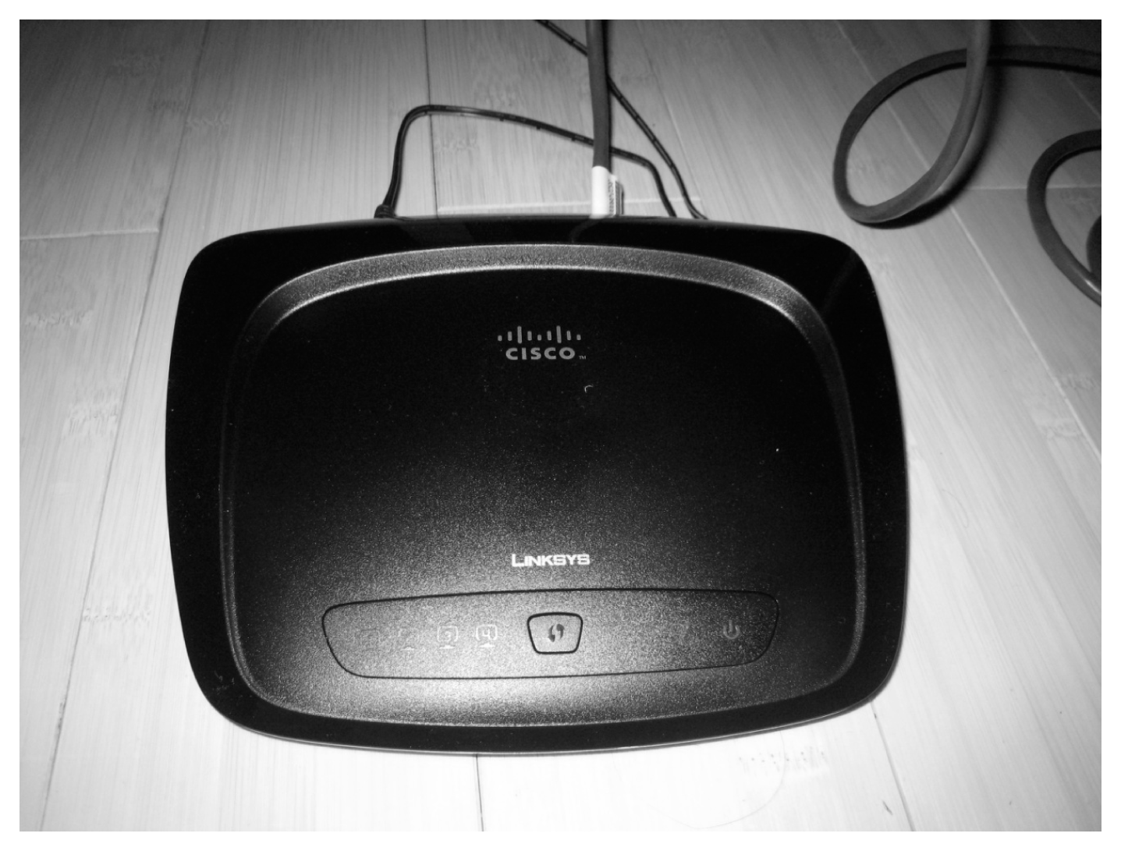
From Network Forensics, by Sherri Davidoff and Jonathan Ham (ISBN: 978-0-13-256471-7) Copyright © 2012 Pearson Education, Inc. All rights reserved.
Figure 6.7 This is one of the second-generation WRT54G wireless routers from Linksys (now Cisco of course). This device is an extremely common sight in homes and small offices, though its slim lines and low profile make it relatively inconspicuous.

Slide 18
Wireless Traffic Capture and Analysis
Spectrum analysis
IEEE utilizes three frequency ranges:
2.4GHz (802.11b/g/n)
3.6GHz (802.11y)
5GHz (802.11a/h/j/n)
Wireless passive evidence acquisition
Refer back to Chapter 3 for passive evidence acquisition

Slide 19
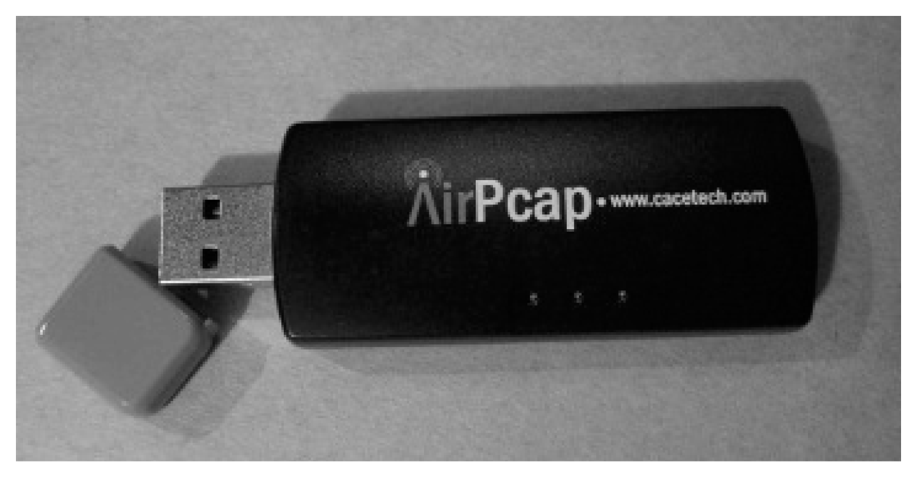
From Network Forensics, by Sherri Davidoff and Jonathan Ham (ISBN: 978-0-13-256471-7) Copyright © 2012 Pearson Education, Inc. All rights reserved.
Figure 6.8 The AirPcap USB adapter from Riverbed Technology (previously CACE Technologies).

Slide 20
Wireless Traffic Capture and Analysis (con’t)
Analyzing 802.11 efficiently
Tools:
Tshark and tcpdump
Find WAPs
Find the encrypted data frames
Notes:
Questions you may want to answer in your investigation of 802.11 frames;
Are there any beacons in the wireless traffic?
Are there any probe responses?
Can you find all the BSSIDs/SSIDs from authenticated/associated traffic?
Can you find malicious traffic? What does that look like?
Is the captured traffic encrypted using WEP/WPA? Is anyone trying to break the encryption?

Slide 21
Common Attacks
Sniffing
Rogue wireless access points
Changing the channel
802.11n greenfield mode (802.11a/b/g devices cannot see the 802.11n device configured in GT mode)
Bluetooth access point
Wireless port knocking
Evil Twin
Used for MiTM attacks
Notes:
Evil Twin attack allows anyone to setup their own WAP with the same SSID as an infrastructure WAP and whenever the Evil Twin’s signal is stronger than the infrastructure WAP, then the client will connect to the Evil Twin. At that point, the ET can then intercept traffic, insert images, or other data.

Slide 22
Common Attacks (con’t)
WEP cracking
WEP is jokingly termed “Weak Encryption Protocol” by security professionals
Tools available to break WEP keys in minutes
Aircrack-ng

Slide 23
Locating Wireless Devices
Gather station descriptors
MAC address of the WAP (contained in the BSSID field in the 802.11 header) See figure 6-9
Identify nearby WAPs
Signal strength
Received signal strength indication (RSSI)
NetStumbler (only works with XP)
Alternative = inSSIDer
Notes:
Strategies for locating wireless devices include:
Gather station descriptors, such as MAC addresses, which can help provide a physical description so that you know what to look for.
For clients, identify the WAP that the station is associated with (by SSID)
Leverage commercial enterprise wireless mapping software
Poll the device’s signal strength
Triangule on the signal
inSSIDer can be found at: http://www.metageek.net/products/inssider/

Slide 24
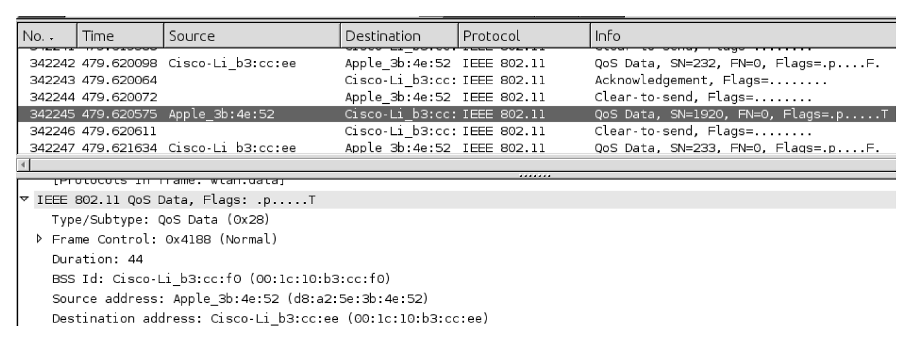
From Network Forensics, by Sherri Davidoff and Jonathan Ham (ISBN: 978-0-13-256471-7) Copyright © 2012 Pearson Education, Inc. All rights reserved.
Figure 6.9 An 802.11 frame from an Apple device to a Cisco wireless router. Note that Wireshark automatically translates the OUI into a human-readable manufacturer description.

Slide 25
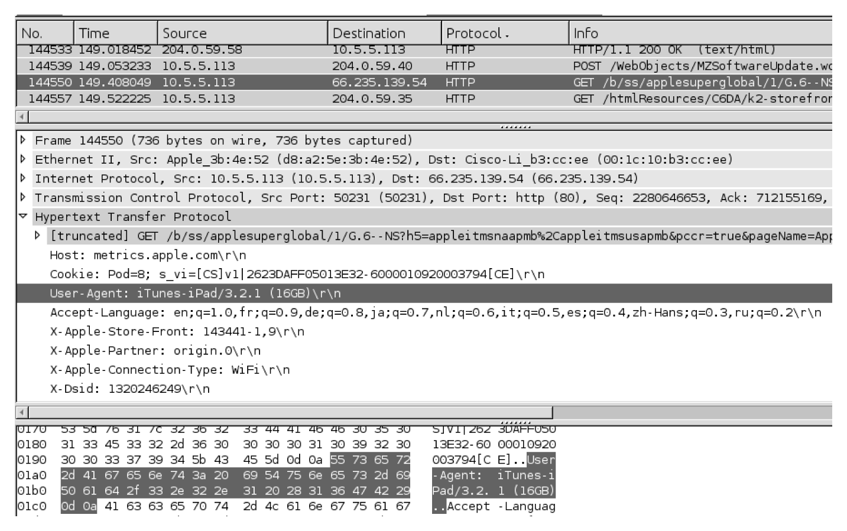
From Network Forensics, by Sherri Davidoff and Jonathan Ham (ISBN: 978-0-13-256471-7) Copyright © 2012 Pearson Education, Inc. All rights reserved.
Figure 6.10 With the packet capture WEP-decrypted, we can see the User-Agent client-side HTTP header, which seems to confirm that the device is indeed an Apple.

Slide 26
Locating Wireless Devices (con’t)
Kismet
Linux/UNIX tool that is both free and open-source
Capable of being passive
Provides support for attacks against authentication and encryption
KisMAC
Open source tool for Mac OS X and supports the same essential features as NetStumbler, however can work in passive mode, meaning it can listen to RF signals while not emitting any RF signal itself
Notes:
Kismet features:
Wireshark- and tcpdump-compatible data logging
Network IP range detection
Hidden network SSID decloaking
Graphical mapping of networks
Manufacturer and model identification of access points and clients
Detection of known default access point configurations
Runtime decoding of WEP packets for known networks
Named pipe output for integration with other tools, such as a Layer 3 IDS like Snort
Distributed remote drone sniffing
XML output
Over 20 supported card types
KisMAC features:
Reveals hidden/cloaked/closed SSIDs
Shows logged-in clients (with corresponding MAC addresses, IP addresses, and signal strengths)
Mapping and GPS support
Can draw area maps of network coverage
PCAP import and export
Support for 802.11b/g
Different attacks against encrypted networks
De-authentication attacks
AppleScript-able
Kismet drone support (capture from a Kismet drone)
Crypto attack support:
Bruteforce attacks against LEAP, WPA, and WEP
Weak scheduling attack against WEP
Newsham 21-bit attack against WEP

Slide 27
Locating Wireless Devices (con’t)
Commercial enterprise tools
Skyhook (Wireless Positioning System (WPS))
Popular alternative to GPS
Accurate within 10-30 meters
Works indoors
Used by iPhones, which tag photos with GPS coordinates

Slide 28
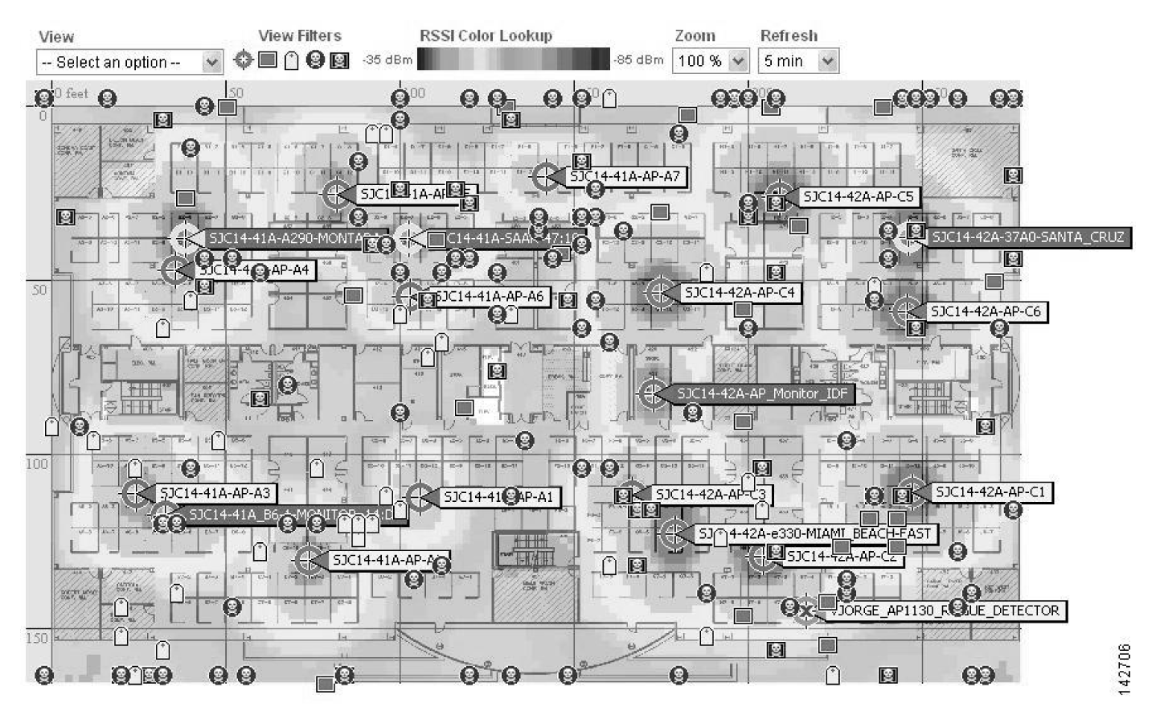
From Network Forensics, by Sherri Davidoff and Jonathan Ham (ISBN: 978-0-13-256471-7) Copyright © 2012 Pearson Education, Inc. All rights reserved.
Figure 6.11 A screenshot of Cisco’s Wireless Location Appliance, which displays devices located on an enterprise floor map and allows system administrators to search and sort. This is WLA’s main view, listing stations detected, BSSID, signal strength, and more. Known devices are marked with a box, while “rogue” devices are labeled with a skull. Courtesy of Cisco Systems, Inc. Unauthorized use not permitted.

